Slide 1
BUDGET SALES ANALYSIS

Slide 2
Agenda
Objective
Problem Statement
The process
KPI
Insights
Conclusion

Slide 3
Objective
The collection includes records for sales orders, customer information, product information, and geographical data.
To deduce important metrics and patterns in the dataset, this project will use the provided data to perform ETL and data analysis.
Additionally, several visualizations and reports are created to represent significant linkages.

Slide 4
Problem Statement
Our "Domain Sale" process is structured to help potential buyers purchase the domain they want immediately without the hassle of contacting the seller directly.
A seller lists a domain for sale at a specific price in our Marketplace. An interested buyer sees this domain for sale and decides to buy it.

Slide 5

The Process
Data Collection
Data Cleaning
Data Analysis
Insights

Slide 6
Data Collection
This step involves extracting the data from different sources relevant to the problem statement or obtaining data from the client.
It consist of:
Dataset 1: AdventureWorks_Database
Columns: ProductKey,OrderDate,ShipDate,CustomerKey,PromotionKey,SalesTerritoryKey,SalesOrderNumber,SalesOrderLineNumber, orderQuantity,UnitPrice TotalProductCost,SalesAmount, StandardCost,List Price, diff std cost and diff list price.
Dataset 2: Budget
Columns: Category, Subcategory, ProductName and Jan-Dec, 2016

Slide 7
Data Cleaning
Python Analysis Process Importing analysis-related Python libraries like Pandas, Numpy, Plotly, etc. Data Wrangling: Gathering, assessing, handling missing data, and adding columns. Exploring Data: Preforming data analysis using Python libraries and Business Intelligence tools like Power BI. Data Modelling: Connecting multiple data sources in BI tool using relationships for creating visualizations. Deployment: Preparing visualizations for public availability on powerbi.microsoft.com site.

Slide 8
Data Analysis

Slide 9
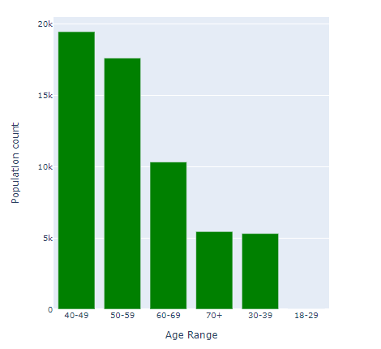
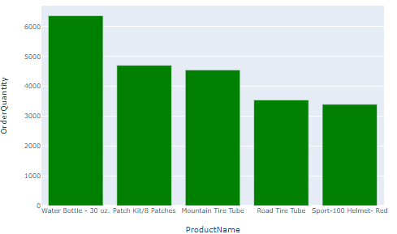
A sizable portion of the clientele is made up of people between the ages of 40 and 59
Top selling 5 companies

Slide 10
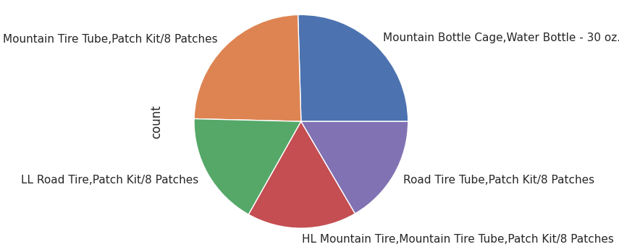
The above product can be sold in a bundle or a combined package for discount

Slide 11
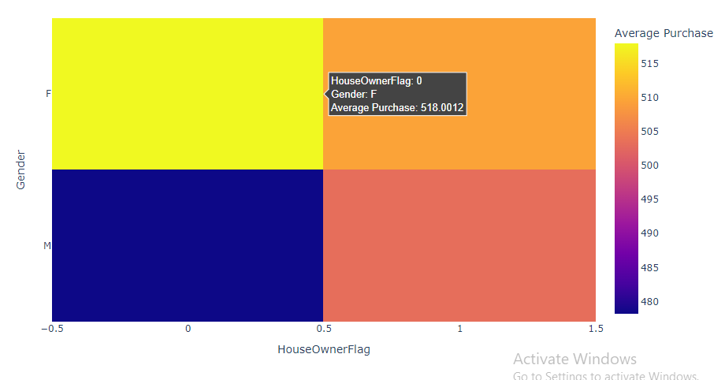
It's interesting to note that the average amount spent by men without permanent addresses is low, whilst the average amount spent by women without permanent addresses is higher

Slide 12
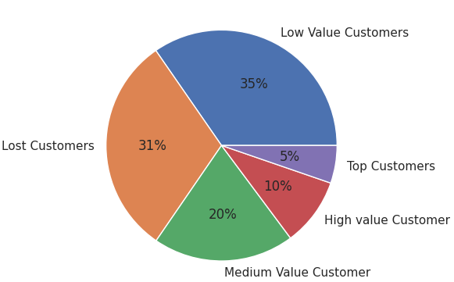
According to the customer segmentation described above, approximately 15% of our clients are high value clients, whereas most of our clientele are low value and lost clients

Slide 13
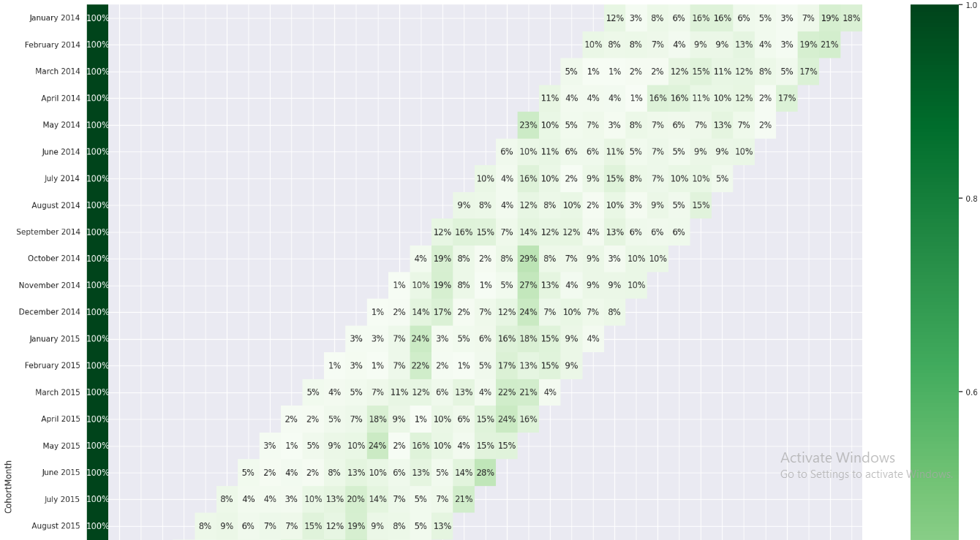
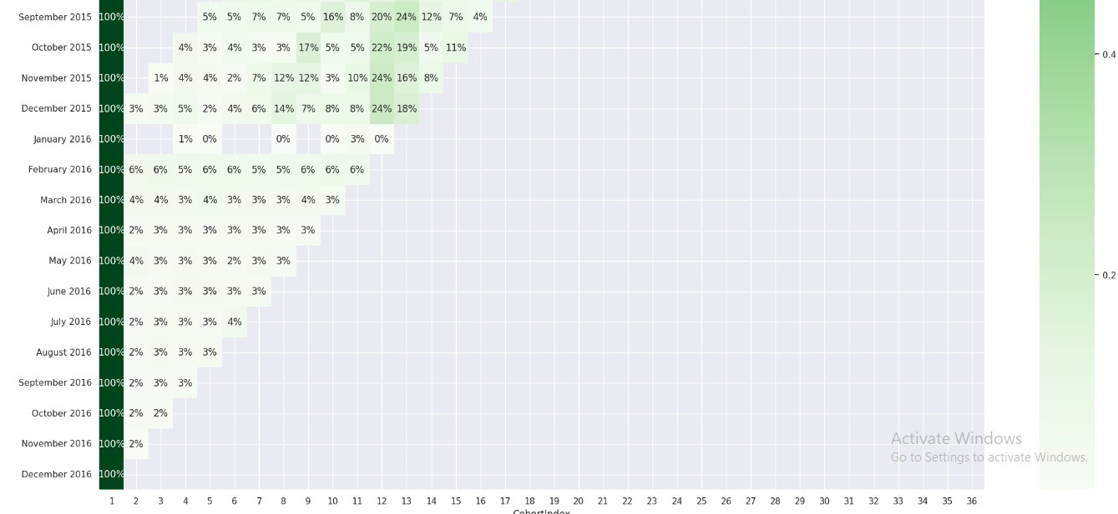
We can infer from the heatmap above that client retention in 2014 was subpar
Since August of 2015, we have noticed some customers returning, though not in large numbers
2016 brought about a slight improvement in retention

Slide 14
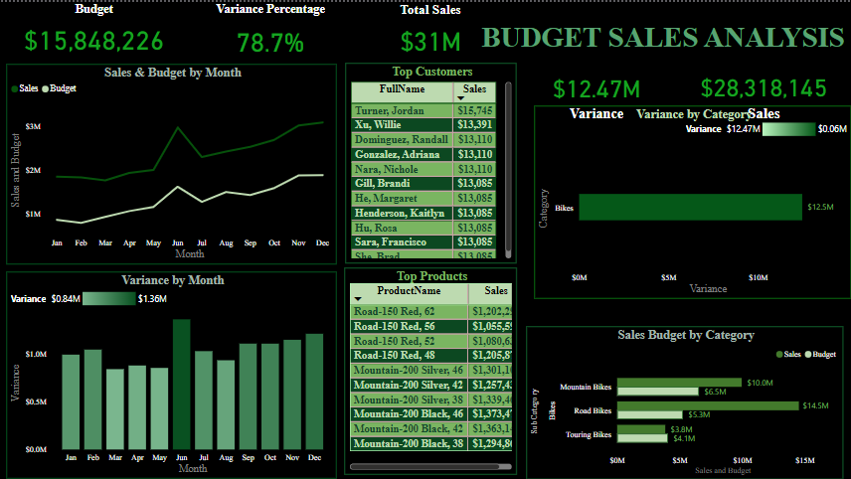
Dashboard 1: Budget Analysis

Slide 15
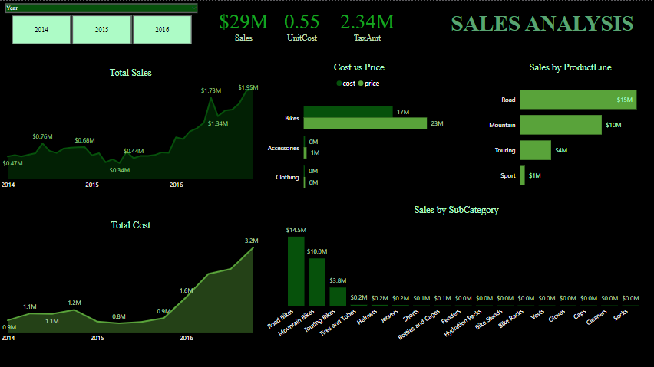
Dashboard 2: Sales Analysis

Slide 16
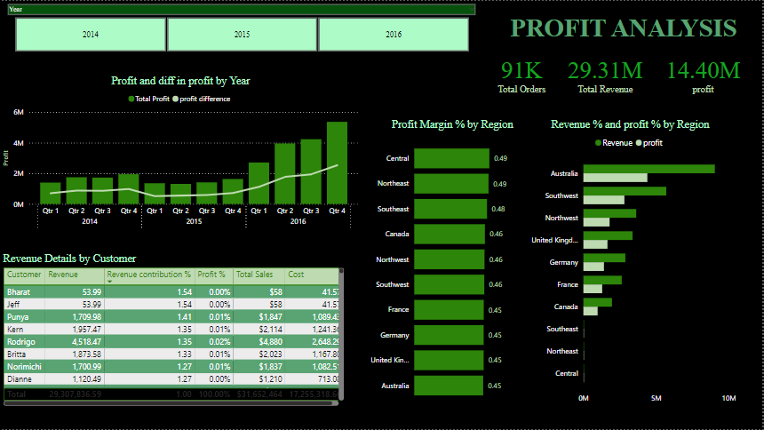
Dashboard 3: Profit Analysis

Slide 17
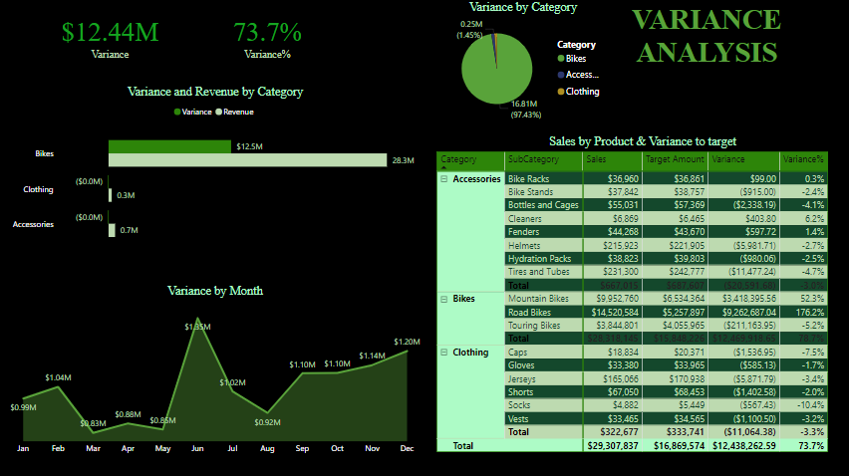
Dashboard 4: Variance Analysis

Slide 18
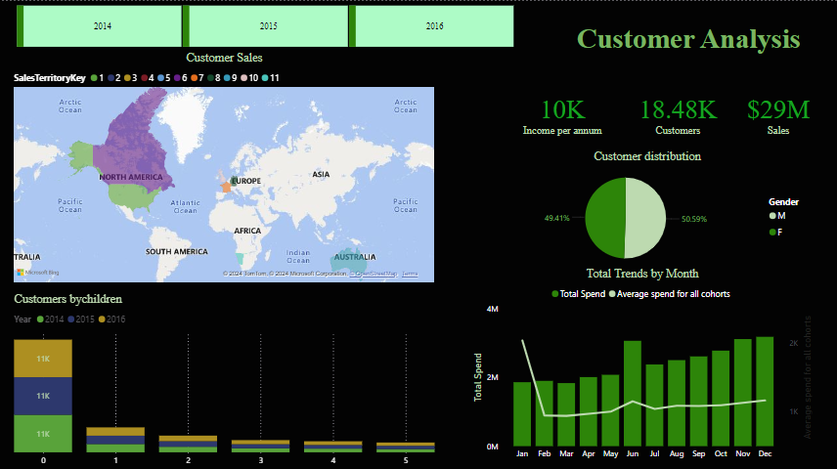
Dashboard 5: Customer Analysis

Slide 19
KPI
Sales trend line
Cost trend line
Average unit cost and price
Revenue generated by Subcategory
Sales by Product Line
Revenue contribution by region
Profit contribution by region
Profit % by region
Current year profit margin vs difference in last year’s profit margin
Total orders
Total revenue
Variance to target comparison by category
Variance by month line chart

Slide 20
KPI
Actual sales and target sales matrix
Cohort analysis
Customer retention line chartable.
Monthly spending trend
Average monthly spend distribution

Slide 21
Conclusion
A sizable portion of the clientele is made up of people between the ages of 40 and 59
The year 2016 saw an exponential surge in sales
High quantity of products is ordered from Australia and United States
Major Profit is contributed by the Bike Category
The average order has a gap of 7 days between the day the order is ready for export from the factory and the date it was shipped
Maximum profit earned in the months of June, November, and December
High sales orders are seen on Wednesday and Saturday, when compared to other weekdays

Slide 22
Conclusion
There is a high negative correlation between Price and number of Quantity ordered
The average amount spent by men without permanent addresses is low, whilst the average amount spent by women without permanent addresses is higher
Age range of 40-49 and 50-59 is shows high demand compared to other age group
High salary range leads to increase in revenue
Customers with a high school diploma and modest annual income buy more products than people with bachelor's degrees
According to the customer segmentation described above, approximately 15% of our clients are high value clients, whereas the majority of our clientele are low value and lost clients

Slide 23
Conclusion
Client retention in 2014 was subpar
2016 brought about a slight improvement in retention

Slide 24
Thank you

